Slide 1




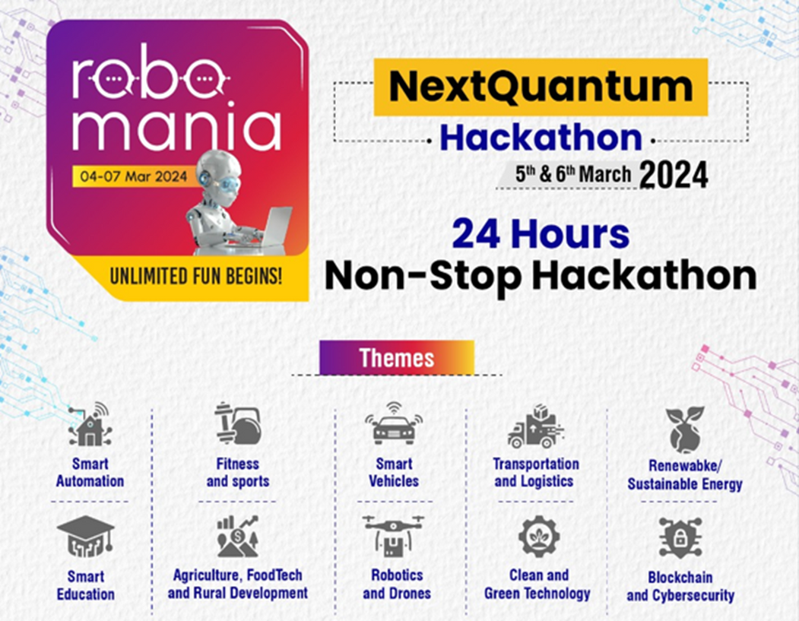


Slide 2







Multiple Disease
Prediction
PRESENTED BY
TEAM NAME:
AKATSUKI PANCHAYAT
Team Leader Name:
Arunangshu P. Bhattacharya
Theme Name:
Smart Automation
Team ID/No.:
NQ16
Institute Name:
CT University

Slide 3
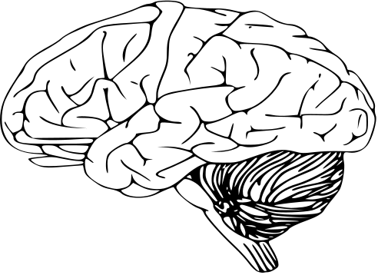
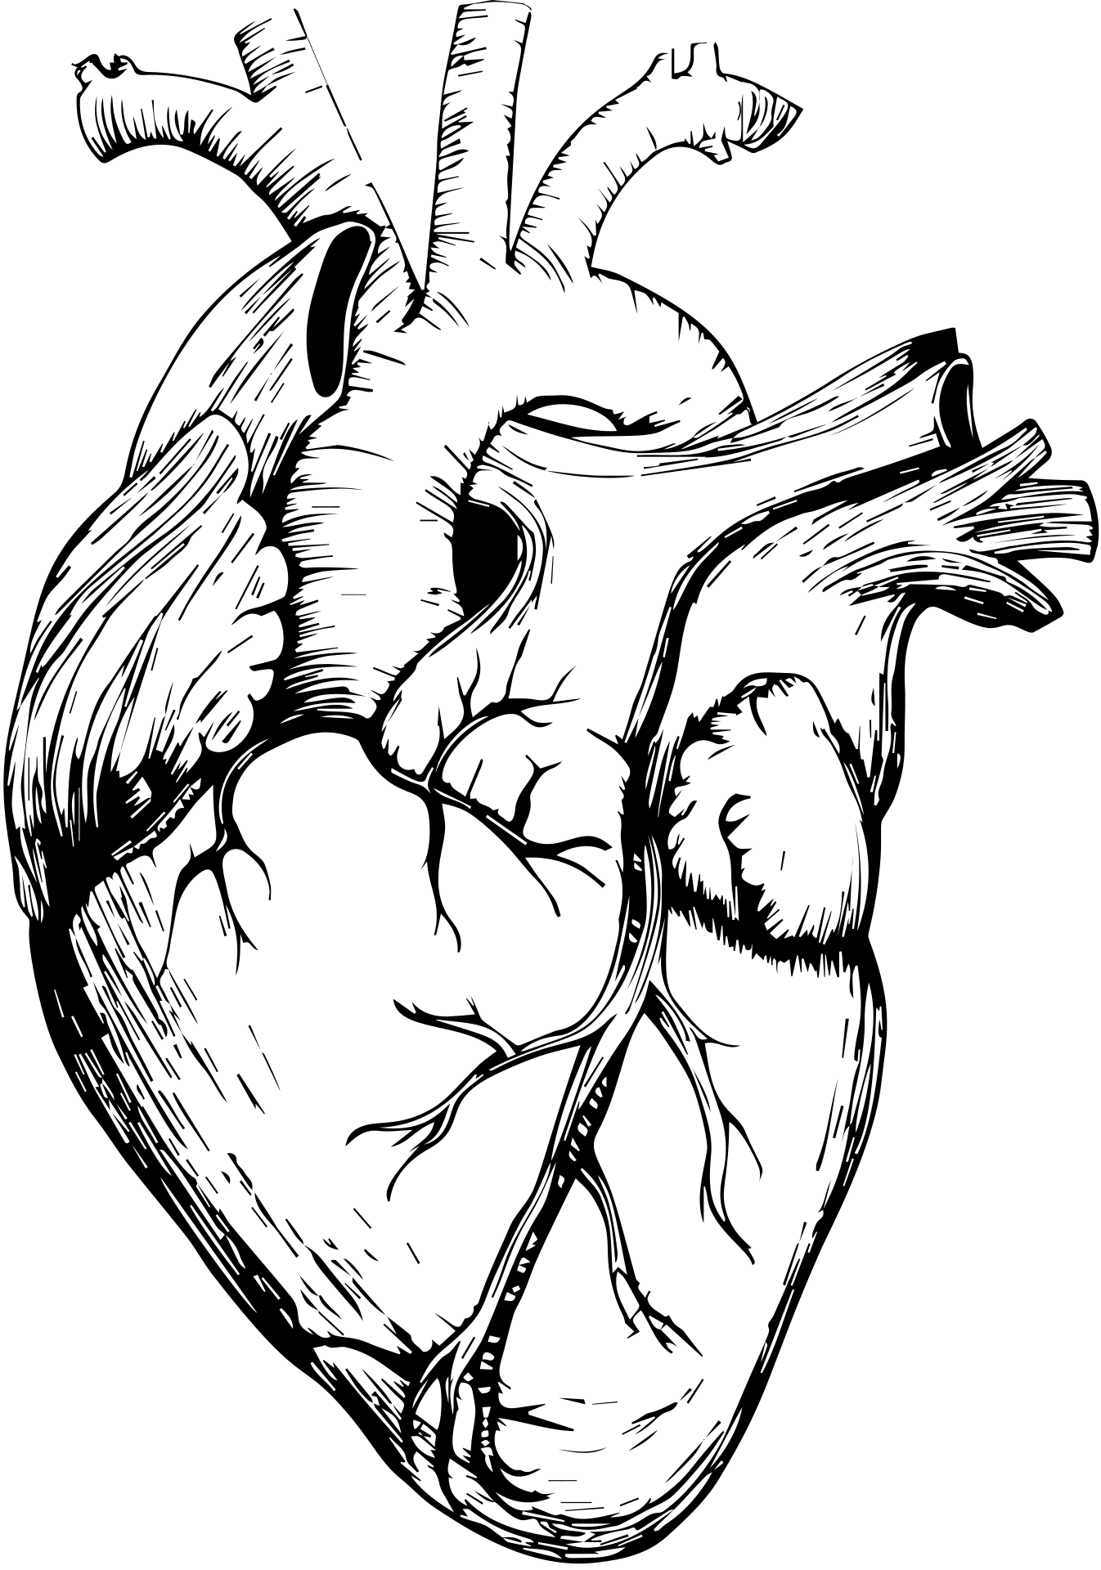


THE AKATSUKI
PANCHAYAT
PRESENTED BY
Introduction
Introducing "The Akatsuki Panchayat," a team of five passionate individuals ready to innovate in multiple disease prediction.
Combining our skills in data science and healthcare, we aim to create a groundbreaking predictive model. Our teamwork and dedication fuel our drive to excel in the hackathon and make a real impact in healthcare innovation.

Slide 4





THE AKATSUKI
PANCHAYAT
PRESENTED BY
Team Members
Individual Roles
Arunangshu Prasad Bhattacharya
Kamalkant Pareek
Abhinav Rai
Sadik Ahuja
Tushar
AP Bhattacharya and Tushar in AI Technology, while Abhinav and Sadik specialize in Interface Design.
Kamalkant brings expertise in blockchain technology. Together, we blend our skills to create a comprehensive and innovative solution for multiple desease prediction.

Slide 5


THE AKATSUKI
panchayat
Problem Statement
PRESENTED BY
Our project aims to develop an accurate and user-friendly multiple diseases prediction system. By leveraging advanced technology and data analysis, we seek to empower individuals with early detection and proactive management of diseases and hosting on blockchain.

Slide 6




Objectives ( Measurable)
THE AKATSUKI
PANCHAYAT
PRESENTED BY
HIGH PREDICTION ACCURACY
Attain 90% accuracy on our disease prediction model, ensuring reliable early intervention and treatment. This accuracy ensures that both users and healthcare providers can trust the predictions for timely action and improved patient outcomes.
IMPROVED USER INTERFACE
Achieve an 85% usability score in interface testing, enabling users to navigate and interpret disease prediction data effortlessly. A user-friendly interface enhances accessibility for individuals with varying technical expertise, ensuring that the insights generated are easily understandable and actionable.
OPTIMIZED MODEL TRAINING
Implement algorithmic enhancements to reduce model training time by 30%. This optimization streamlines the process of developing and refining the disease prediction model, facilitating its deployment in real-time healthcare scenarios. A faster training time ensures that the model stays up-to-date with the latest data trends and insights, improving its accuracy and effectiveness.

Slide 7
Progress Flow
THE AKATSUKI
PANCHAYAT
PRESENTED BY
Step | Description
1. Collect Approved Dataset | Gather relevant datasets endorsed by medical specialists, ensuring compliance with privacy regulations.
2. Import and Cleanse Data | Import datasets and cleanse them by removing duplicates, handling missing values, and correcting errors.
3. Train and Test Model | Split the dataset, train Support Vector Machine (SVM) and Logistic Regression models, and evaluate them.
4. Optimize Model Performance | Refine model parameters to enhance accuracy using techniques like cross- validation and grid search.
5. Develop User Interface | Design an intuitive and visually appealing interface for easy interaction with the prediction system.
6. Host Web App on Blockchain | Implement blockchain technology for heightened security and data integrity in hosting the web application.

Slide 8


THE AKATSUKI
PANCHAYAT
Idea/ Approach / Technology Stack
PRESENTED BY
Idea/Approach:
Our project aims to predict diabetes early on, improving healthcare outcomes.
We collect trusted medical data, clean and analyze it, then train advanced
models like SVM and Logistic Regression. We design a user-friendly interface
for easy use.
To secure data, we host the system on blockchain.
Our approach prioritizes accuracy, usability, and data security for better
healthcare solutions.
Technology Stack:
Our technology stack includes Python for data analysis and machine
learning models, Flask for web application development, HTML/CSS for
user interface design, and blockchain for data security. We integrate
these tools to create a robust and user-friendly diabetes prediction system.

Slide 9

THE AKATSUKI
PANCHAYAT
PRESENTED BY
About Proposed Solution/Prototype(Phase - I)
Our proposed solution is a disease prediction system utilizing sophisticated machine learning algorithms. It analyzes diverse medical data to anticipate the onset of various diseases, facilitating proactive healthcare interventions. With a user-friendly interface and blockchain security integration, our solution prioritizes accuracy, accessibility, and data privacy for enhanced healthcare outcomes.

Slide 10

Methods/ Algorithms/Code Quality(Phase - II)
THE AKATSUKI
PANCHAYAT
PRESENTED BY
Category | Description
Methods | We employ supervised machine learning methods for disease prediction, including Support Vector Machine (SVM) and Logistic Regression.
Algorithms | Support Vector Machine (SVM): Used for classification tasks, SVM is effective in handling high-dimensional data and finding optimal decision boundaries. - Logistic Regression: A widely used algorithm for binary classification, Logistic Regression is interpretable and efficient.
Code Quality | We adhere to best coding practices, ensuring readability, modularity, and documentation. We conduct regular code reviews and employ version control systems like Git.

Slide 11

Final Solution/Prototype/Business Solution
THE AKATSUKI
PANCHAYAT
PRESENTED BY
Aspect | Description
Objective | Develop a robust disease prediction system leveraging advanced machine learning for early intervention and improved healthcare outcomes.
Prototype Features | Accurate Disease Prediction: Utilizes SVM and Logistic Regression for precise predictions. User-Friendly Interface: Designed for ease of use and accessibility. Blockchain Integration: Ensures secure and private data hosting.
Technology Stack | Data Analysis and ML Models: Python (Scikit-learn, Pandas) Web Development: Flask, HTML/CSS Security: Blockchain integration for data security.
Code Quality | Adheres to best coding practices, emphasizing readability, modularity, and documentation. Conducts regular code reviews and utilizes version control (Git).
Business Impact | Enhances healthcare by enabling early disease prediction, leading to proactive interventions and improved patient outcomes.
Future Enhancements | Explore real-time data updates, additional disease prediction models, and user engagement features based on user feedback.

Slide 12



THE AKATSUKI
PANCHAYAT
PRESENTED BY
Test Cases/Use Cases
Early Diabetes
Detection:
Heart Disease Risk Assessment:
Preventive Care Reminder System:
Users input health data.
System predicts diabetes risk.
Users receive personalized recommendations.
Healthcare providers input patient data.
System assesses heart disease risk.
Providers recommend tailored care.
System sends proactive reminders.
Users follow personalized recommendations.
System updates based on user feedback.

Slide 13
Conclusions / Future Scope
Aspect | Description
Conclusions | 1. Disease prediction system is effective in early detection. 2. User interface design enhances accessibility and usability. 3. Blockchain integration ensures data security and privacy.
Future Scope | 1. Explore real-time data updates for improved predictions. 2. Enhance model accuracy by integrating additional algorithms. 3. Expand system capabilities to predict a wider range of diseases.

Slide 14
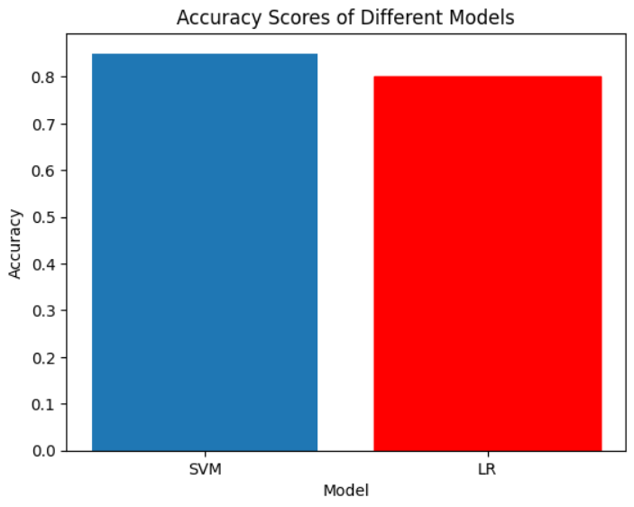
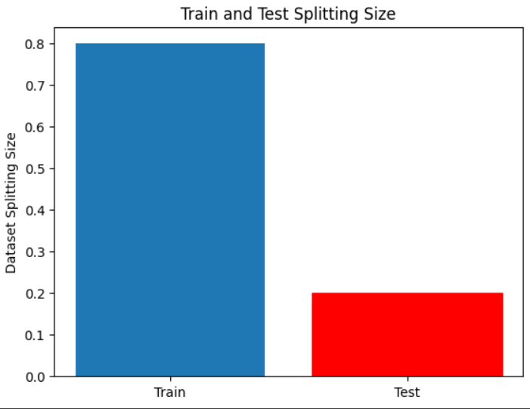
THE AKATSUKI
PANCHAYAT
PRESENTED BY
So, here is the Accuracy Score of different Models, these models were applied in the project and was implemented successfully with better results.
So, here is the splitting part of Train and Test of dataset, 80% is used for testing and 20& is used for the testing part.

Slide 15
References / Acknowledgements
THE AKATSUKI
PANCHAYAT
PRESENTED BY
REFERENCES
ACKNOWLEDGEMENTS
Research papers
Banoth Ramesh, G. Srinivas, P. Ram Praneeth Reddy, MD Huraib Rasool, Divya Rawat, and Madhulita Sundaray contributed to predicting multiple diseases and authored research papers on the topic.
Online Resources (e.g., Kaggle for Dataset, Blackbox AI):
Utilizing Kaggle for datasets and Blackbox AI for problem-solving when stuck provides valuable online resources to enhance our project's efficiency and effectiveness.
Previous Studies (College Academic, Self-Study):
Drawing from college academic studies and self-study endeavors enriches our understanding, equipping us with diverse knowledge to address complex challenges effectively.
Team members
Our group of 5 members where we engaged in discussions, shared ideas, and collaborated closely throughout the project.
Mentors
Our university mentors provided invaluable guidance, support, and expertise, enhancing the quality and direction of our work.
Institutions
Our University imparted essential domain knowledge, laying the foundation for our understanding and exploration of the project's subject matter.

Slide 16


THANK YOU
THE AKATSUKI
PANCHAYAT
PRESENTED BY
PRESENTED BY
AKATSUKI PANCHAYAT

